Slide 1
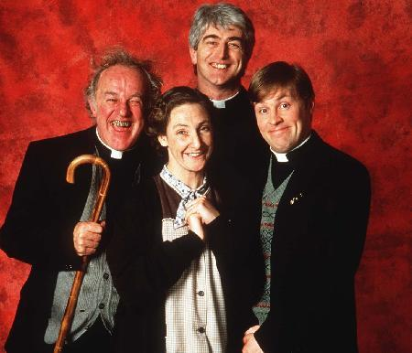
Your Team with Awesome Photo

Slide 2

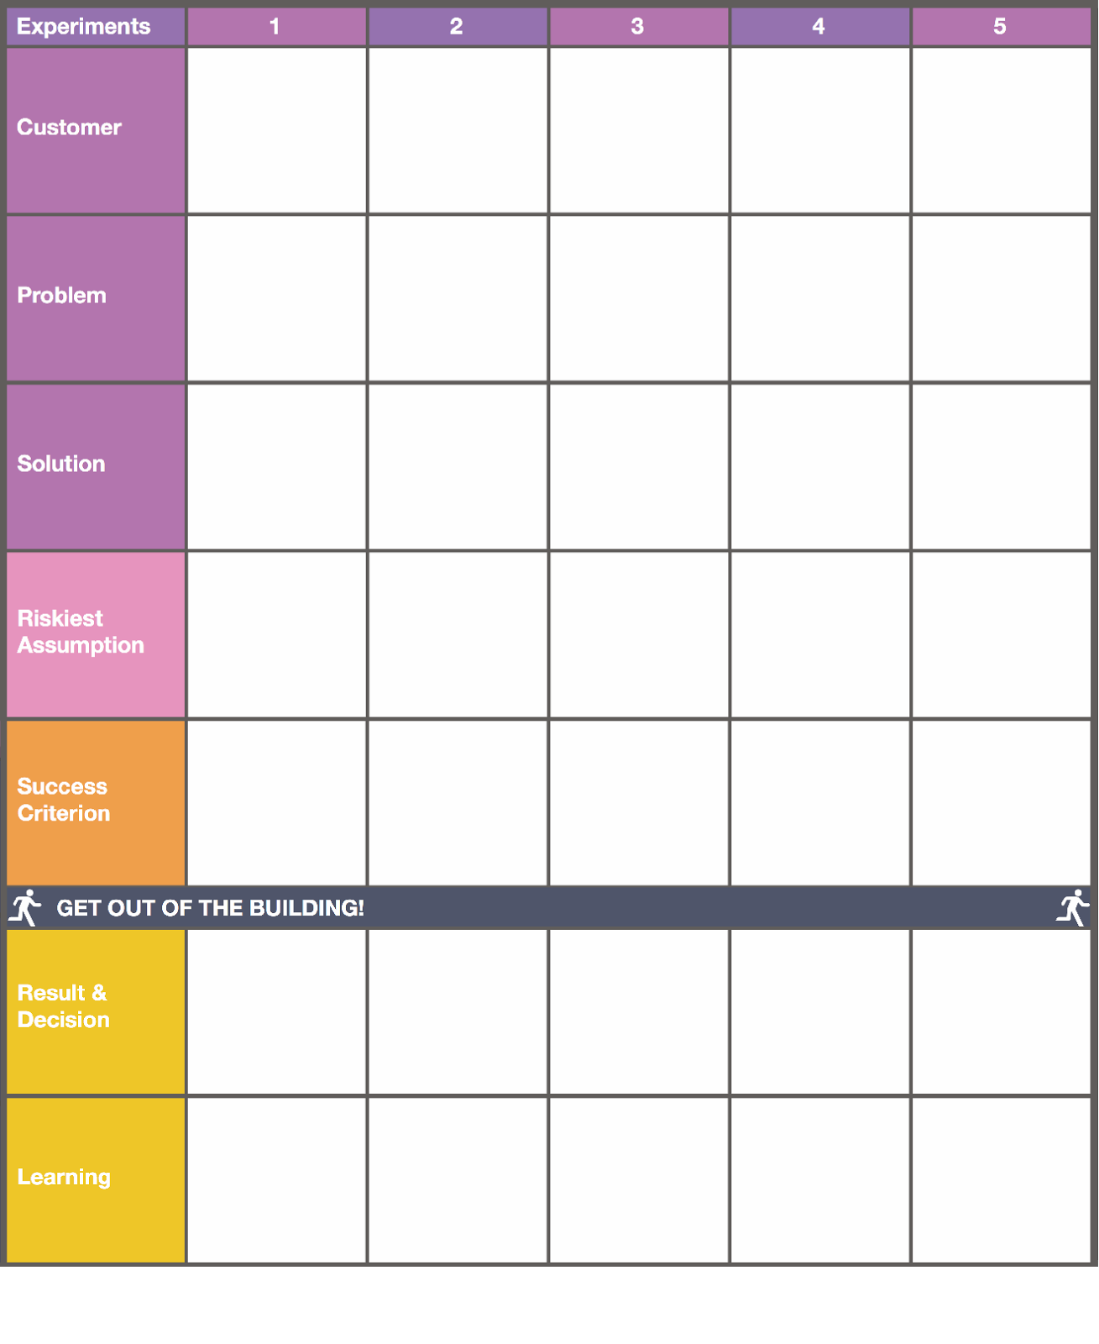

Time-poor City residents
Time poor city resident shopping W/O a list
Single,
time poor people
Single time poor people
Single time poor
London based
Single time poor
London based
UX
Designers
SCarcity of time/knowledge
People eat the same thing too often
No time to shop & decide on ingredients
Landing page presentation
People aren’t sold on message through text advert
Don’t have energy to shop for weekend adventures
Ready Groceries
Set Menus
Go Cook it
Sign up
Call to action
Buy
Call to Action
Show people the physical product
W/e high/end ingredient pack delivered to office on Fri for culinary adventures
People don’t know what to buy
People are unhappy eating the same food over and over
People value a set bag of ingreditents & set recipe
People do not have sufficient exposure for quick adoption
People want to cook on weekends rather than during the week
Call to action inappropriate for service
Interview
80% want more variety
Sign-ups:
20%-40%
Sign-up rate
5%
Above 0 sign-ups
Sign-up rate 5%
Interview:
6-8/10
15 interviewees /80% agree
Persevere
85% eat same thing and are bored
7% sign-ups
Problem exists, solution wrong
See you on Mon!
:)
0%
sign-ups,
18 clicks
0 sign-ups
FOf Nos 50% buy the same stuff every week
People want it laid out and easy instructions. Minimise waste
Communication method was fundamentally flawed
Get out and sell face to face
Get out and sell face to face
Yuppies want variety and adventure only on weekends

Slide 3
Most Impressive, Final Validation Metrics Here

